Slide 1

Analysis on the Legalization of Recreational Marijuana in the State of Colorado
UCI Data Analytics Bootcamp
Team 5
Josh, Peter, Sai, Stefanie
September 18, 2018

Slide 2
Does the legalization of commercial sale of marijuana affect median household income?
Data Analysis Methodology
Income data was downloaded from factfinder.census.gov.
Income data was gathered for the years of 2012-2016. We will be comparing the median household income of the years prior to and after the legalization of commercial sales of marijuana by looking specifically in areas where there is a presence marijuana dispensaries.

Slide 3
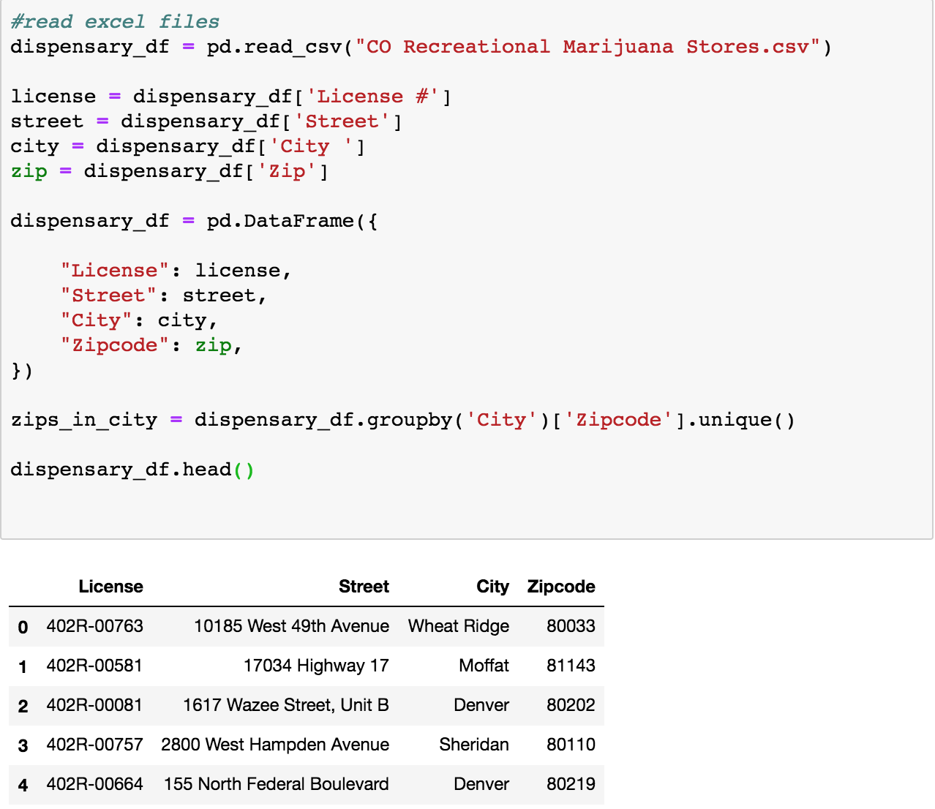
Code Snippets

Slide 4
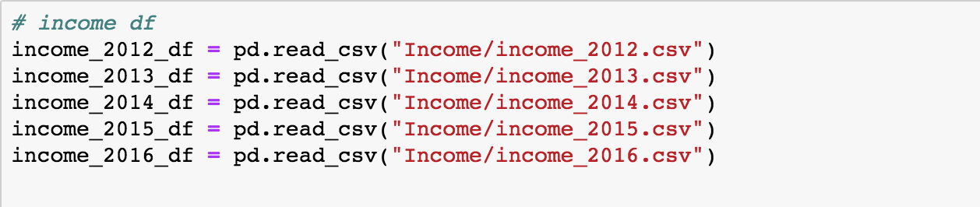
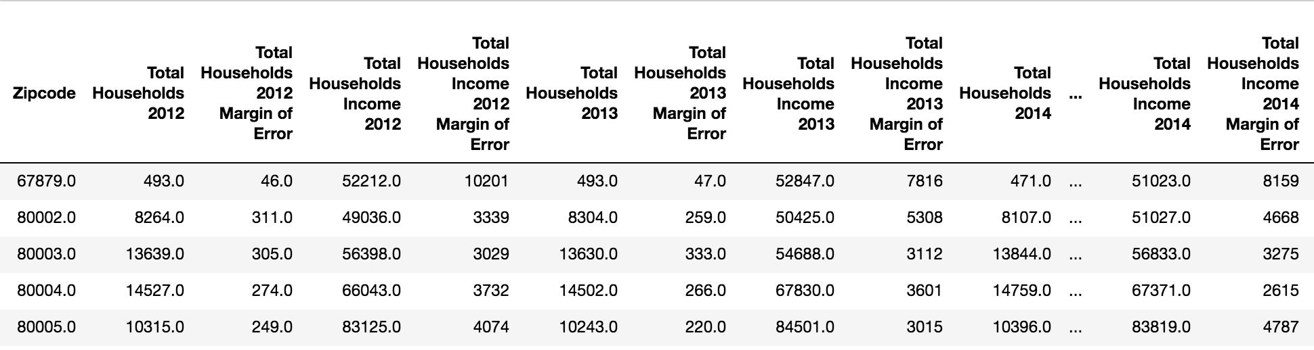
Code Snippets

Slide 5
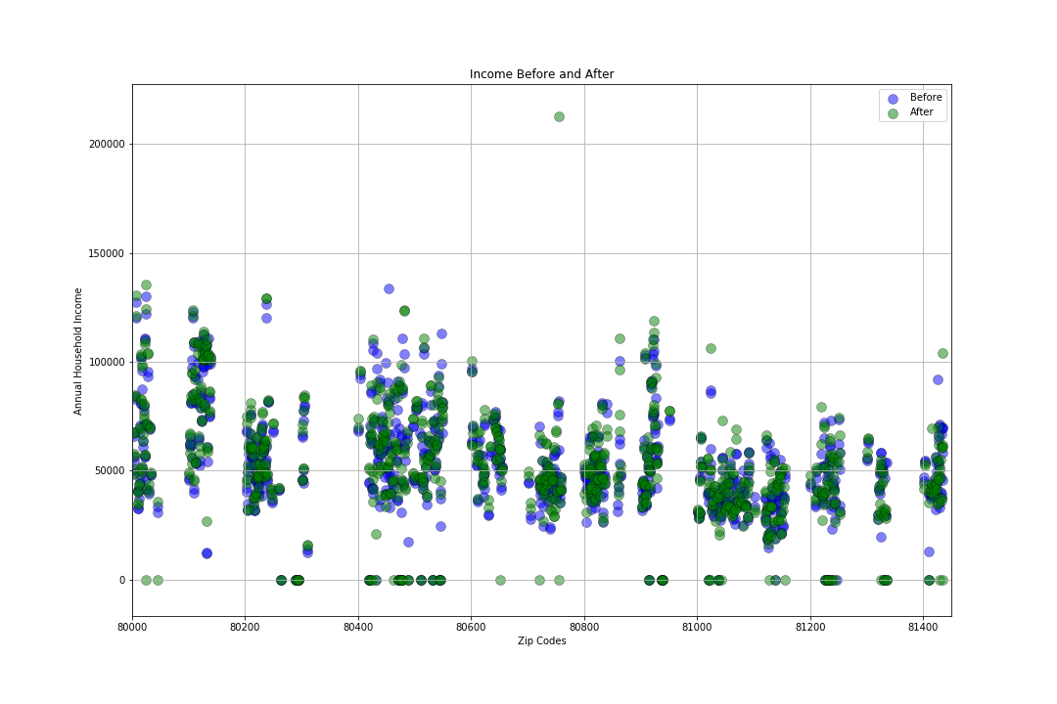
Analysis
Here, we plotted the median household income for each zip code. The blue markers represent income prior to the legalization of commercial sales
Based on the data, we concluded the legalization of commercial sale of marijuana had no observable impact on median household income

Slide 6
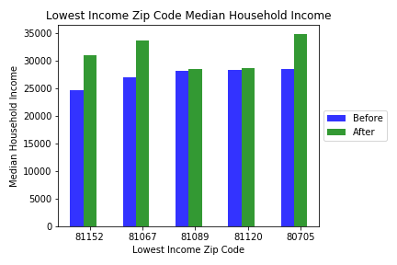
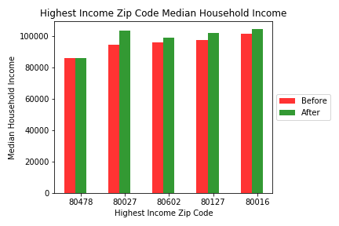
We calculated the average median household income for the years before legalization and the years after. We compared the before and after differences of the zip codes that had the lowest and highest median household income. The graphs show that income increased slightly for 7 out of the 10 samples.

Slide 7
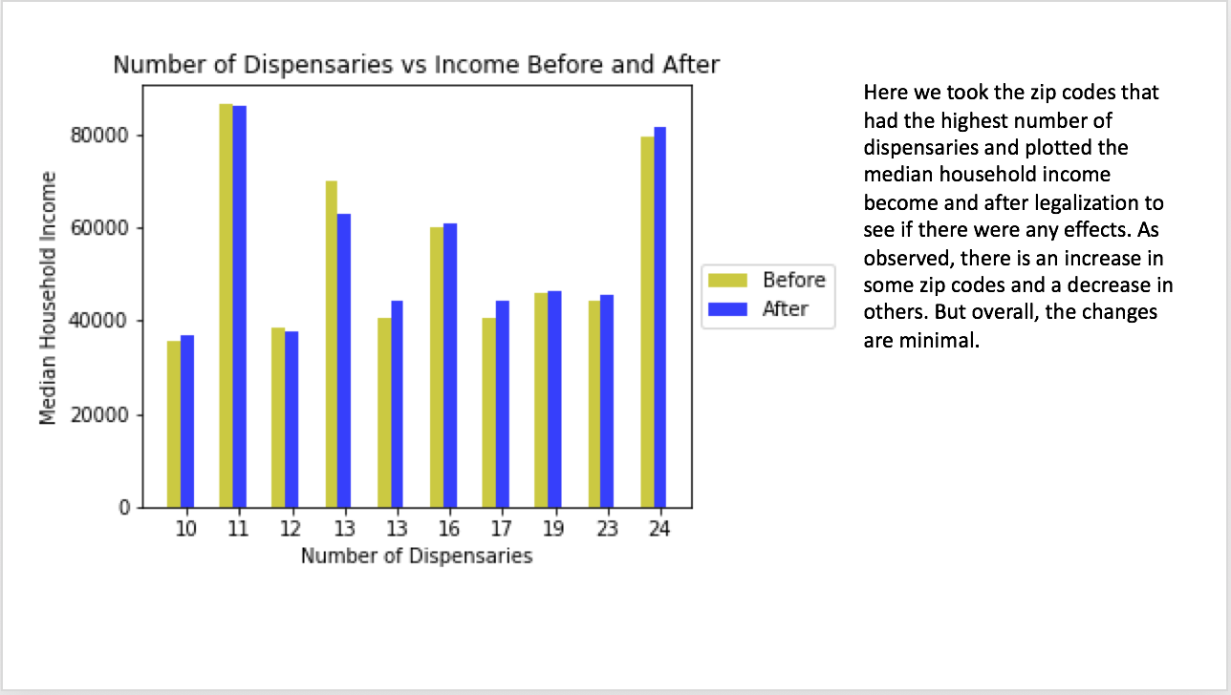

Slide 8
Does the legalization of commercial sale of marijuana affect unemployment?
Data Analysis Methodology
Income data was downloaded from factfinder.census.gov.
Income data was gathered for the years of 2012-2016. We will be comparing the the unemployment rates for various age groups. We would like to see if the presence of marijuana dispensaries decrease unemployment rates through job creation or adversely increase unemployment rates

Slide 9
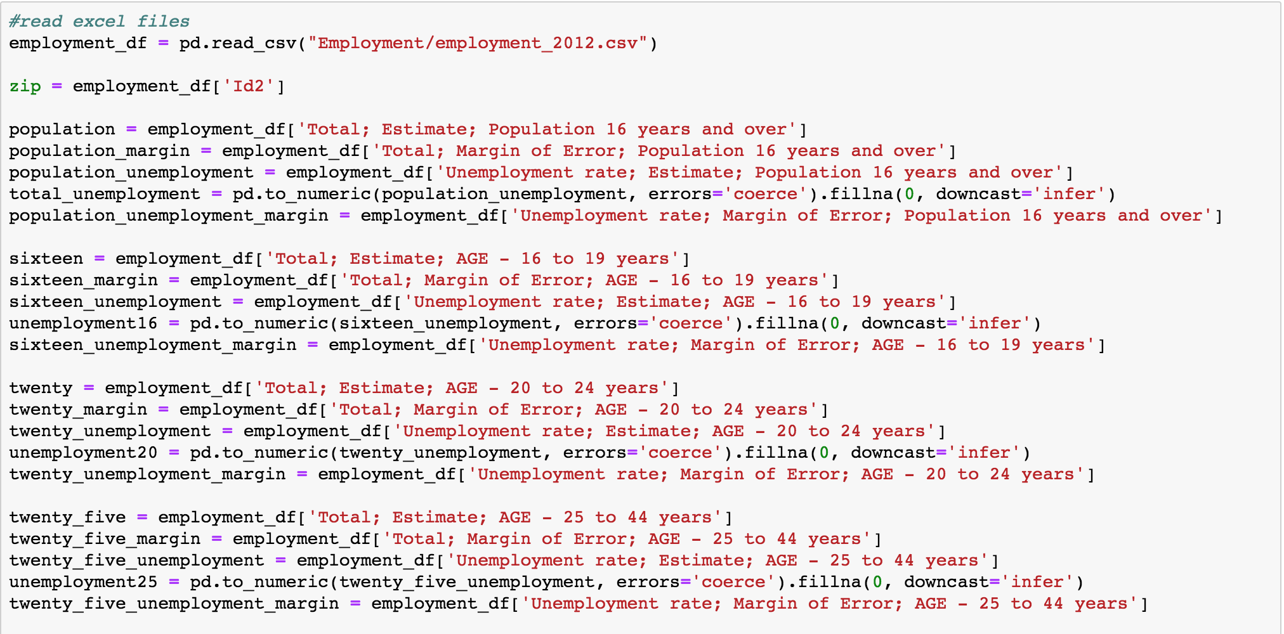
Code Snippets

Slide 10
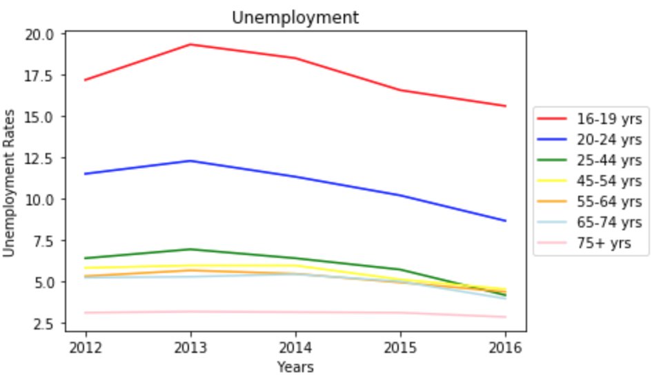
The legalization of commercial marijuana sales began in 2014 so that is our point of comparison. There appears to be a drop in unemployment rates for all age groups after legalization. Excluding all other factors that affect unemployment and unemployment rates, we can conclude the legalization of commercial sale of marijuana positively affects unemployment.

Slide 11
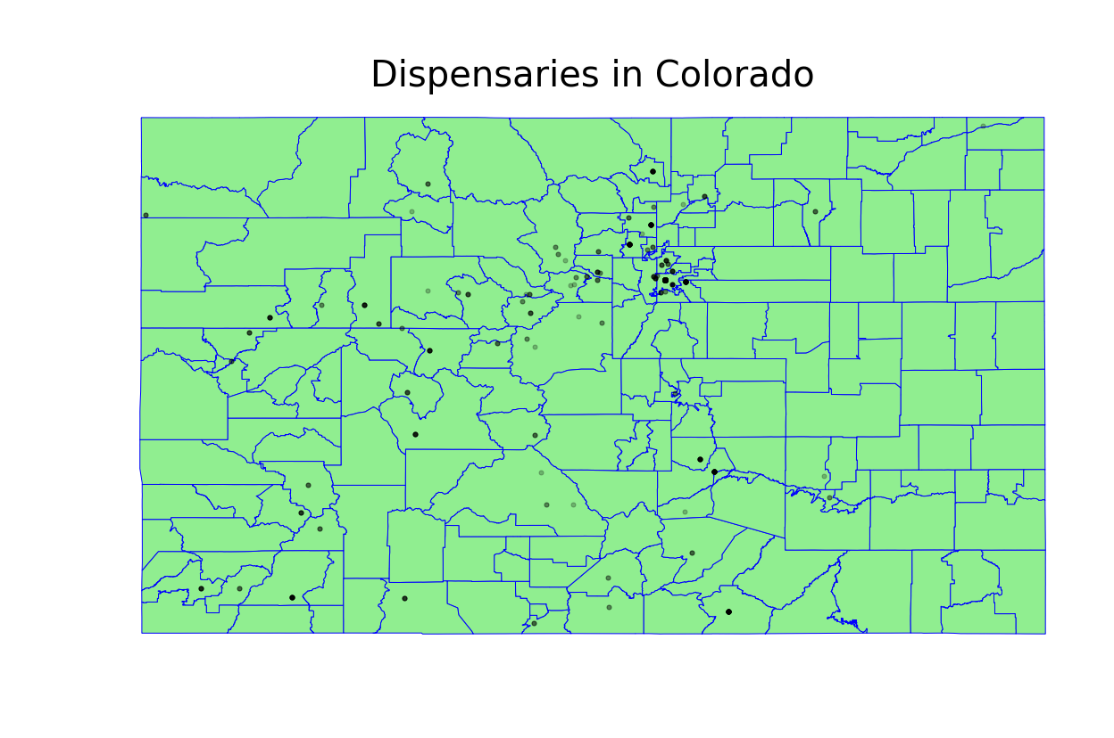

Slide 12
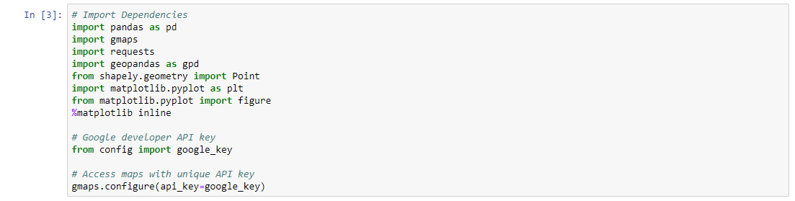
Using GeoPandas to make Map
Importing dependencies

Slide 13
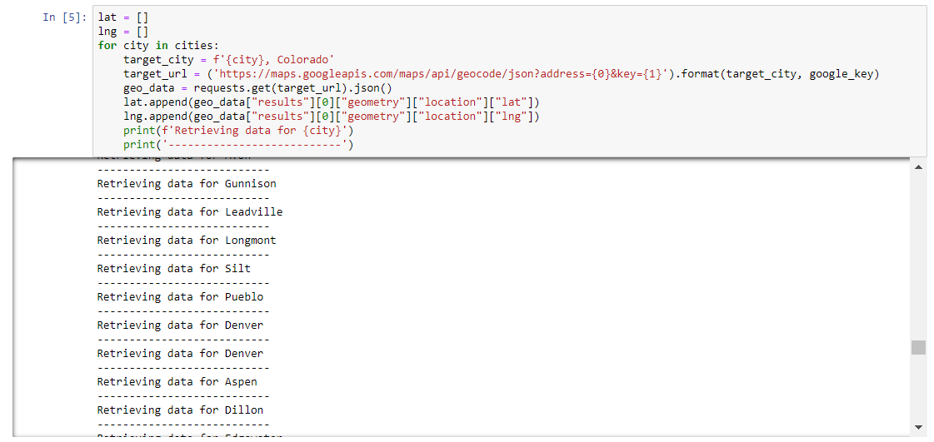
Using GeoPandas to make Map
Retrieving Lat and Lng

Slide 14
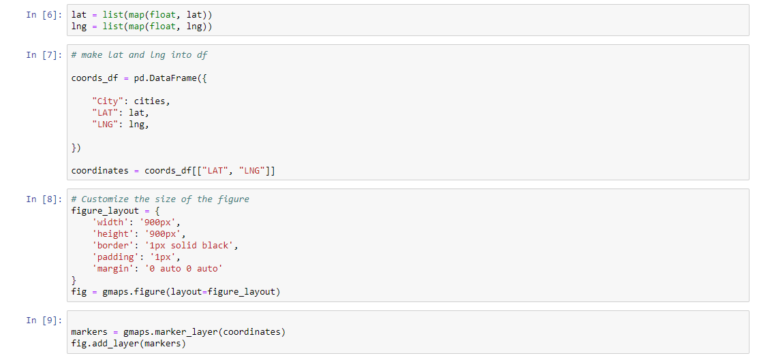
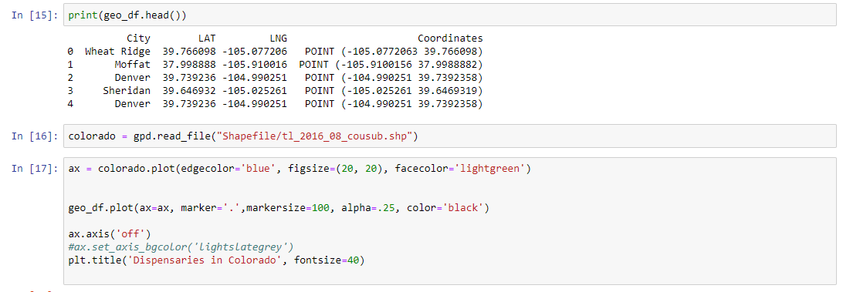
Using GeoPandas to make Map
Making Dataframe and formatting

Slide 15
Using GeoPandas to make Map
Printing geomap

Slide 16
Using GeoPandas to make Map
Dropping NA values

Slide 17
Does legal marijuana effect housing values?
Data Analysis Methodology
Housing values were downloaded from zillow.com. The “Housing Valuation Index (HVI)” was studied.
A list of marijuana stores was downloaded from colorado.gov. The primary data point used in this study was the physical location of the store (street, city and zip code).

Slide 18
CO Housing Price Trends 2012 - 2018
Coding logic
Step 1: Load Zillow housing data from csv into a dataframe
Step 2: Load marijuana stores data from csv into a dataframe
Step 3: Summarize data by decade and group by city
Step 4: Create 2 dataframes – one for cities with no MJ stores and one for cities with MJ stores
Step 5: Build a line graph that depicts overall housing price trends from 2012 – 2018 for the whole state, MJ cities and “dry” cities

Slide 19
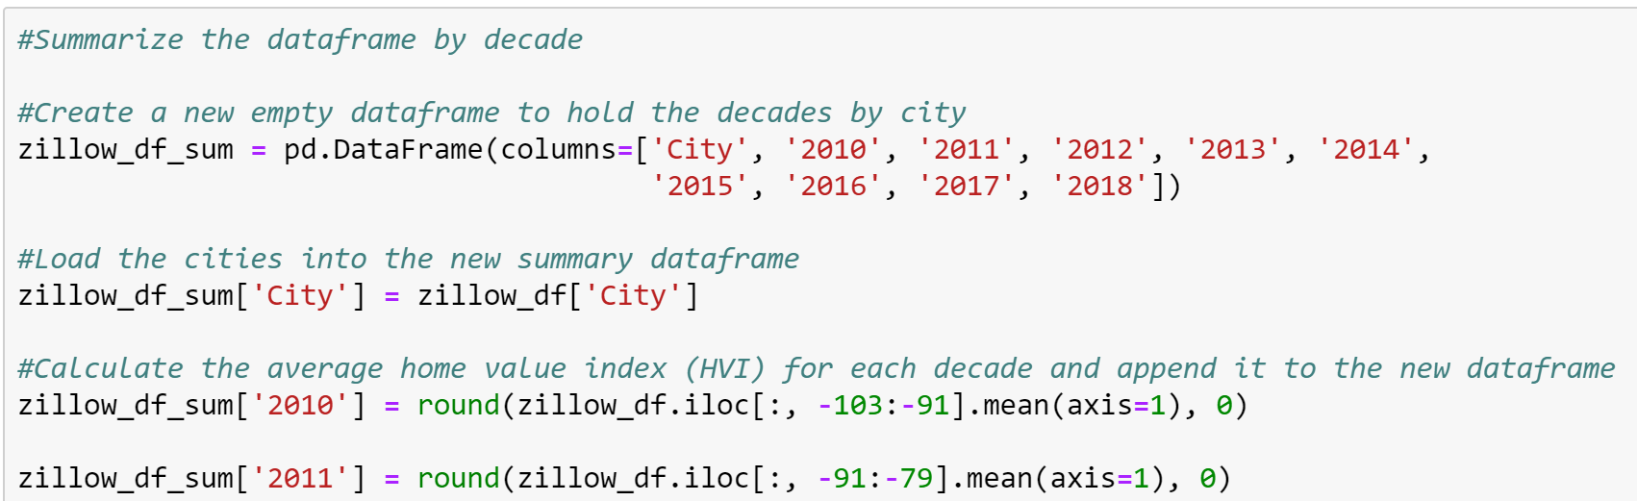
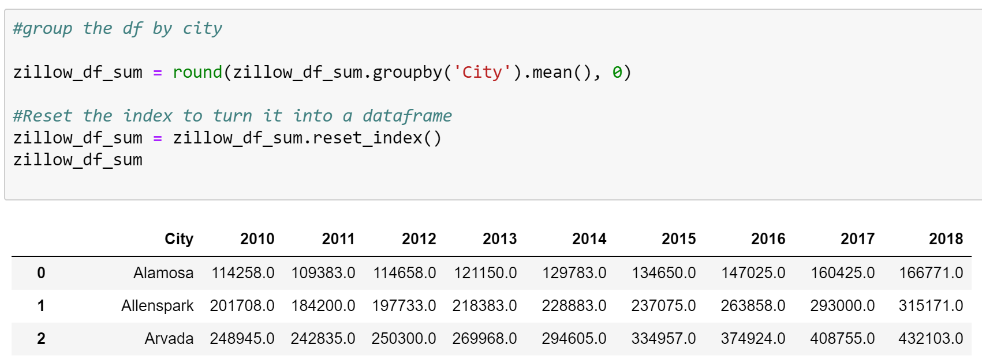
Code Snippets

Slide 20
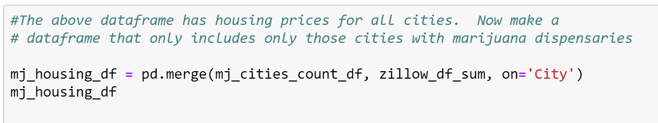
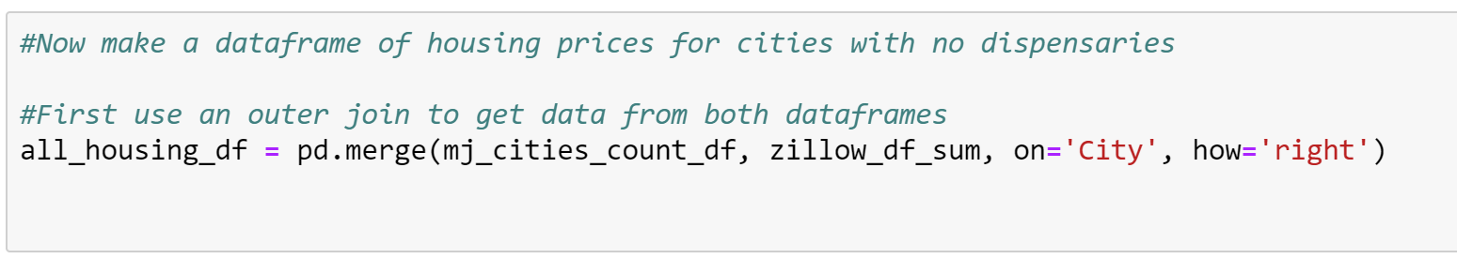
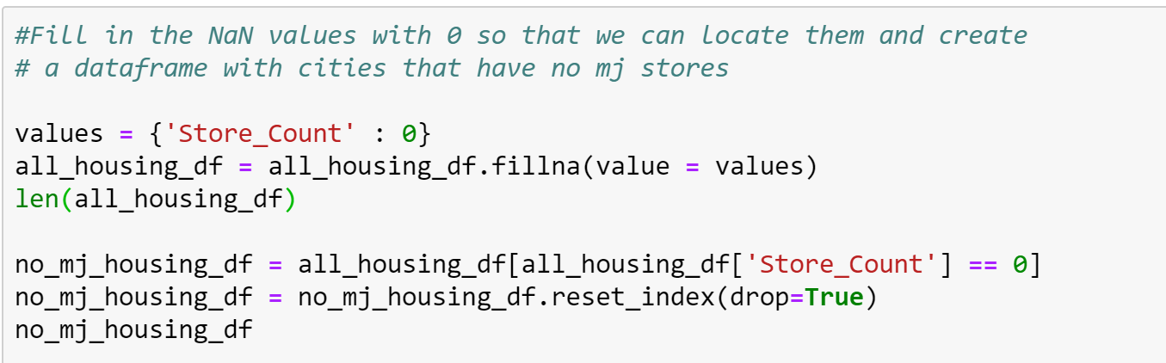

Slide 21
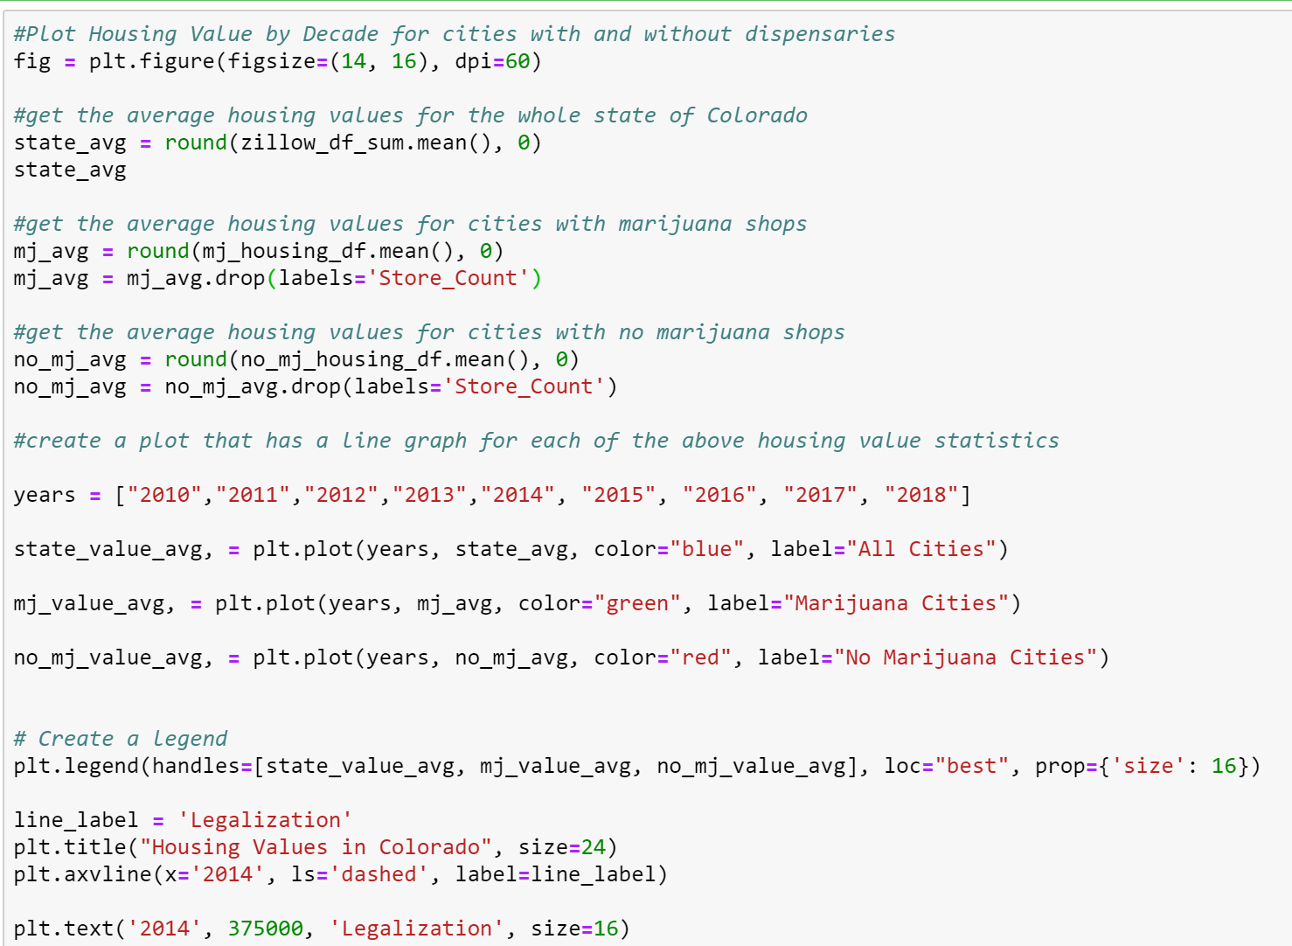

Slide 22
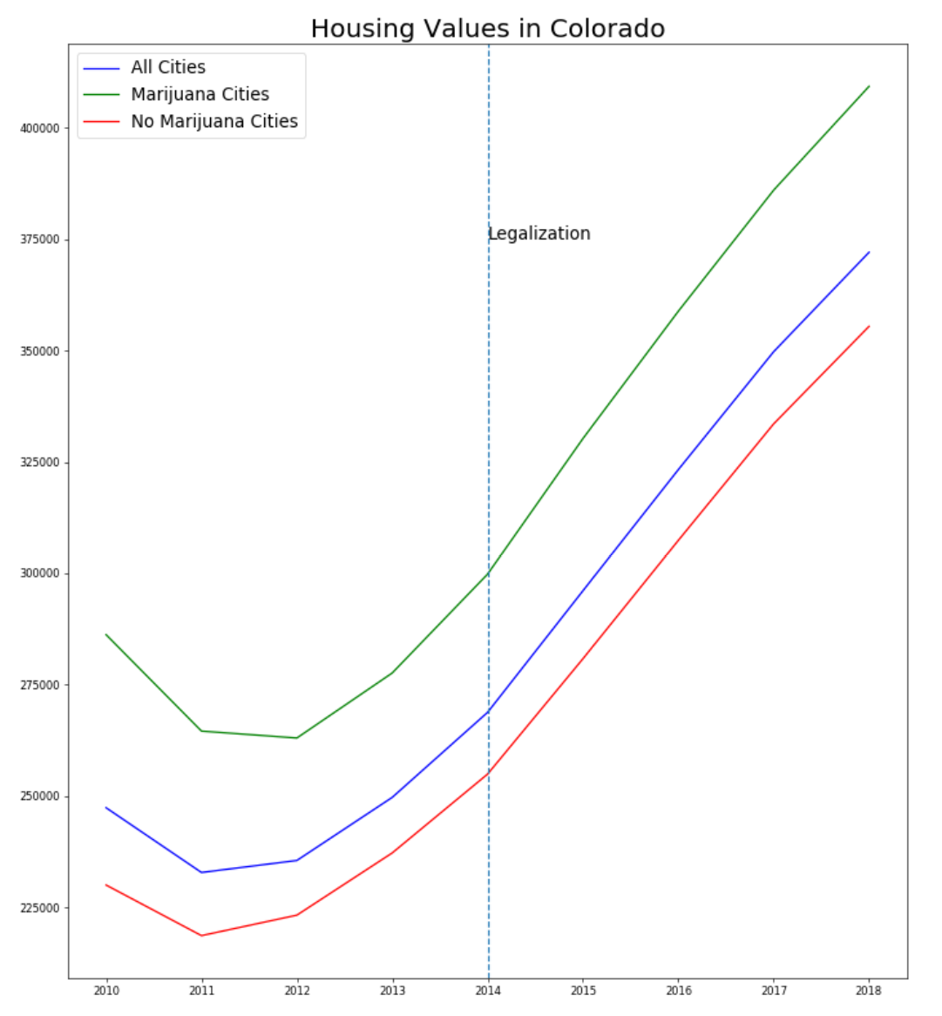
Analysis
Marijuana shops do not appear to affect housing values.
Prices in Colorado were trending up prior to the legalization of recreational marijuana, but after legalization they continued to skyrocket.

Slide 23
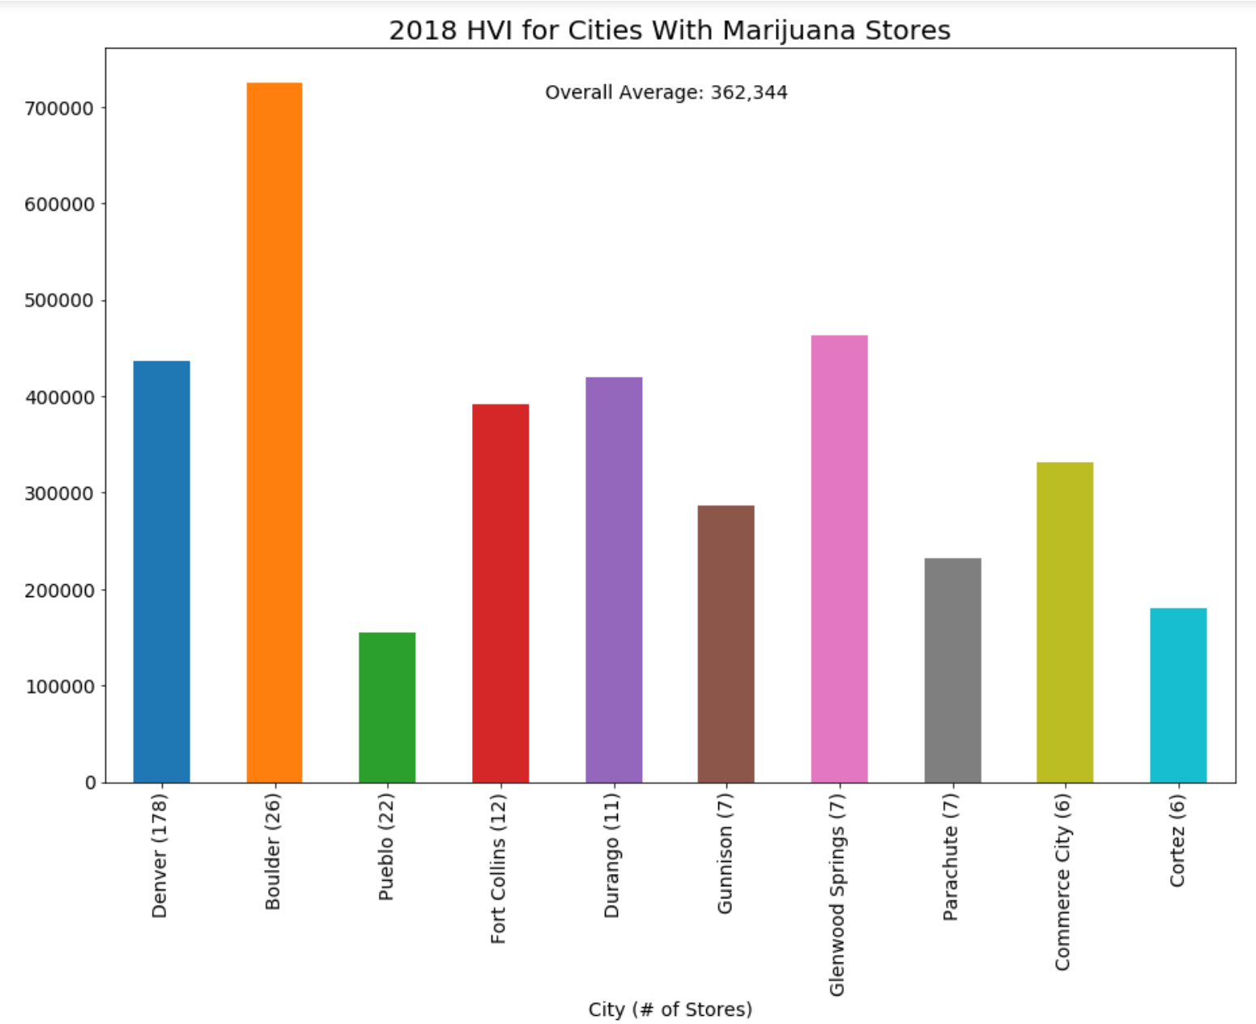
Analysis
Denver, Boulder and Pueblo have the largest number of marijuana shops. (The graph at left shows cities in order of shop #.)
There does not seem to be any correlation between the number of shops and housing prices.
Denver has a population of 719,116 and Boulder has a population of 109,068. This factor does not seem to influence housing prices either.

Slide 24
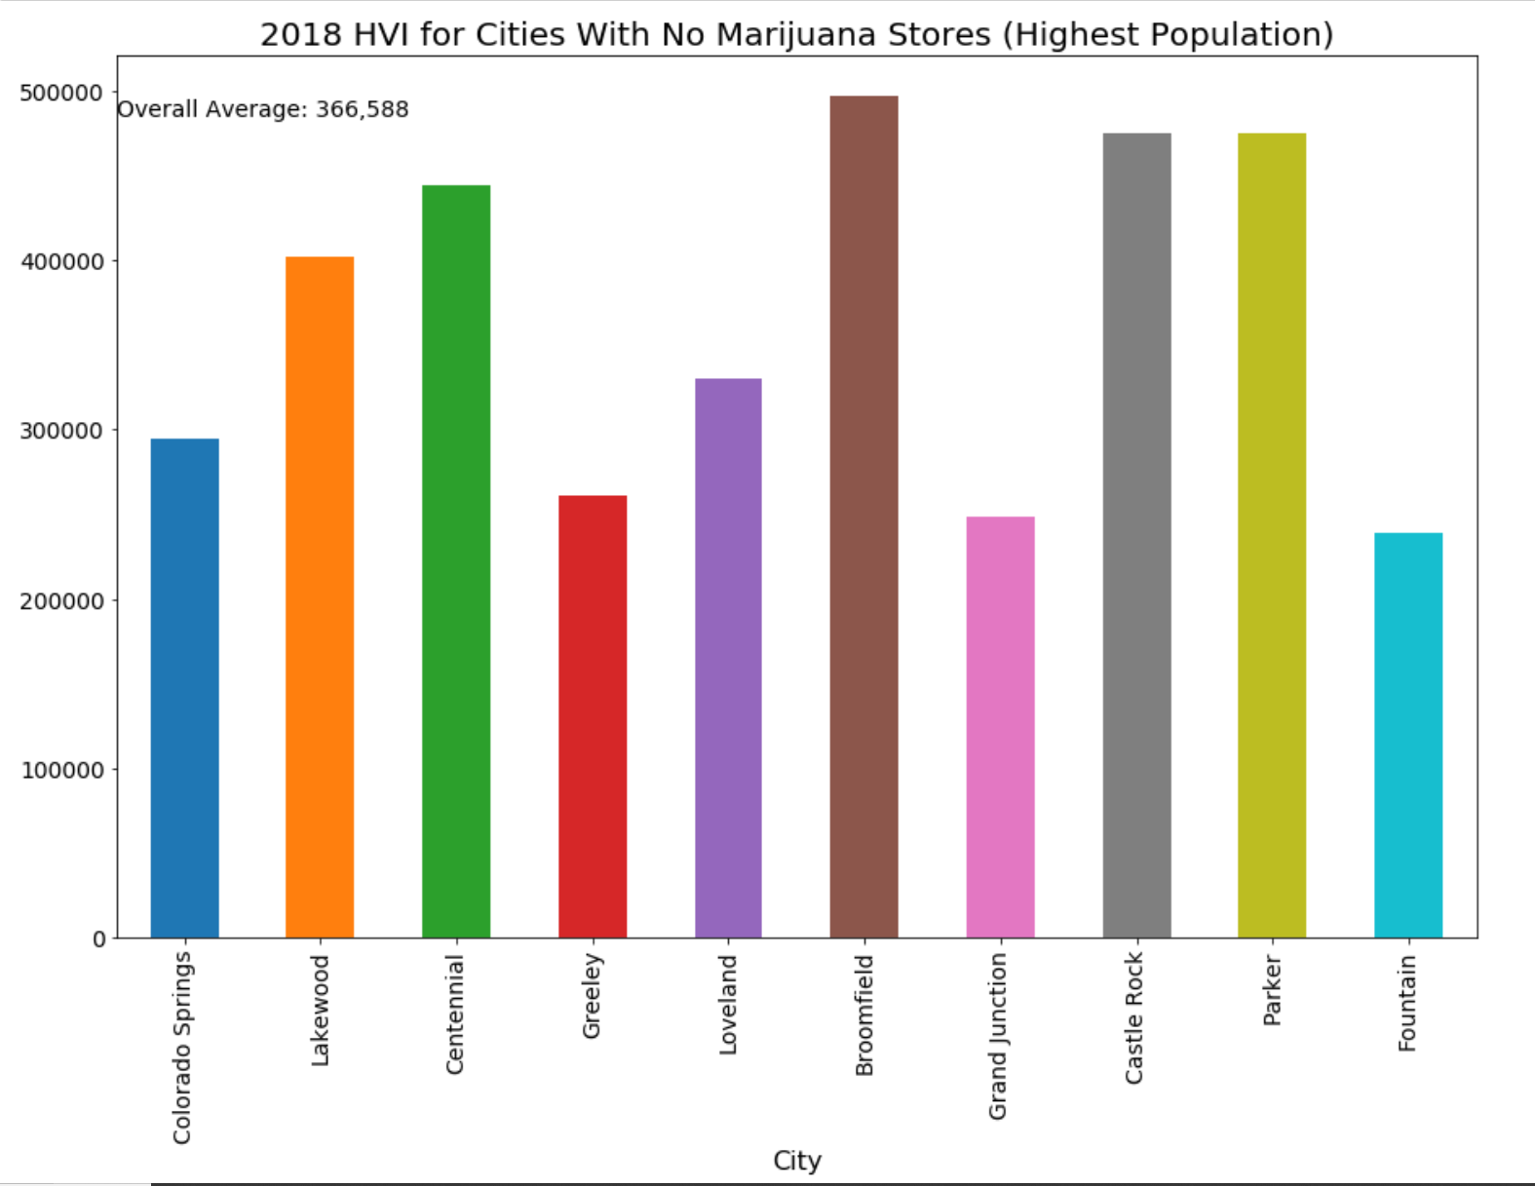
Analysis
For this analysis, we did not have any stores so we used population to decide which cities to include. We wanted to ensure that cities with a very small number of houses were not included as this could skew the housing prices.
The overall average housing price for cities with no marijuana shops is $366,588. This is extremely close to the prior graph (average price was $362,344). We can conclude that marijuana shops do not appear to influence housing prices.
influence housing prices either.

Slide 25
Does legal Marijuana effect crime rate?
Data Analysis Methodology
Crime rate data were downloaded from FBI-NIBRS (National Incident Based Reporting System), which present all reported crime in a city throughout the year.
A list of marijuana stores was downloaded from colorado.gov. The primary data point used in this study was the physical location of the store (street, city and zip code).

Slide 26
Dispensary location vs. crime rate over time
Coding logic
Step 1: using excel file with 2013-2016 crime stats to create new dataframe
Step 2: group the MJ stores DF by city and do count to find number of stores per city
Step 3: merge two dataframe on city and dropna value to keep only city with MJ stores
Step 4: calculate crime rate based on (sum of person and property crime) / population *100
Step 5: build a line graph to see the crime rate change of city with dispensary

Slide 27
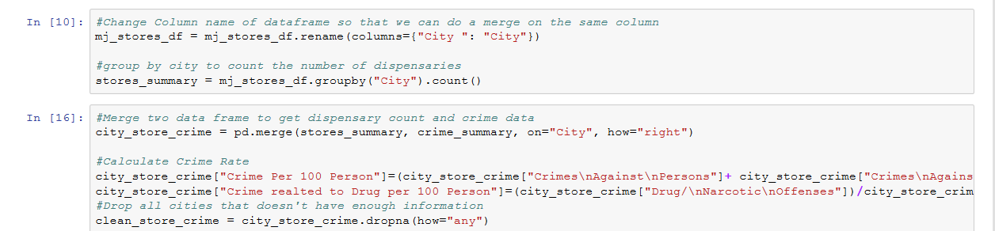
Code Snippets – Data Cleaning

Slide 28
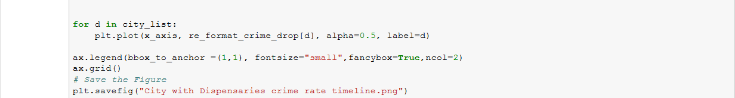
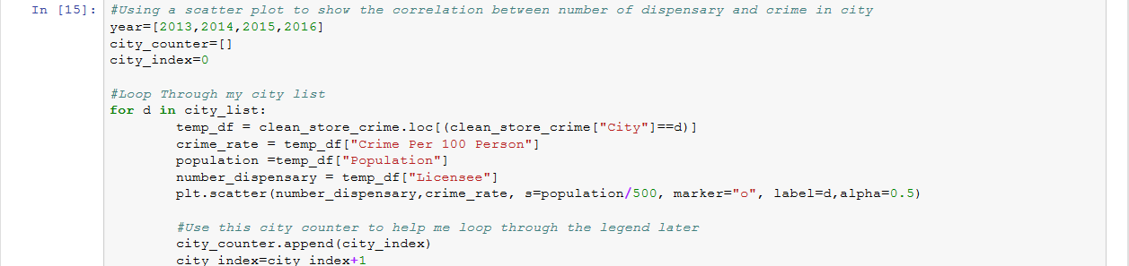
Code Snippets – Plotting

Slide 29
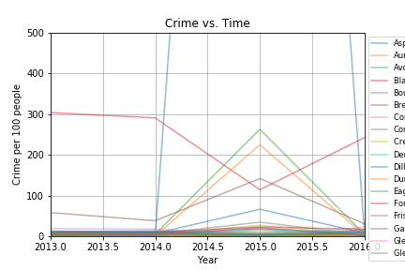
Analysis
Most cities with higher crime rate appear to drop in 2015
However, there are multiple cities with lower crime in 2015, but increased in 2016.
Although the legalization of sales of recreational marijuana took effect in early 2014, it makes sense that it may take some time for the stores to actually open and the 2015 data may still be valid.
However, I was not sure if this is directly related to the legalization of sales of Marijuana

Slide 30
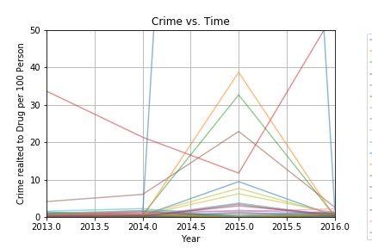
Analysis
This graph focus on Drug related crime only
We observed similar pattern in crime rate changes in the cities, which made the overall crime rate data more relevant.

Slide 31
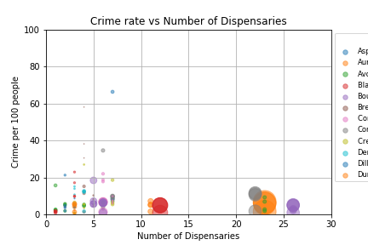
Analysis
Larger city tend to have larger population thus more dispensaries were opened
However, we can see that crime rate tend to be higher with smaller cities which don’t have too many dispensaries.
Few of the data were excluded from the graph by using ylimit for visualization purpose

